Slide 1
Hypothesis Testing
Notes:
Hello all, and welcome to this workshop on hypothesis testing!

Slide 2
What is a hypothesis?
Educated guess
Test that guess with statistics
Notes:
Let’s start with the basics – what is a hypothesis? I like to think of it as an educated guess, or a guess-timate. But even more specific than that, it’s usually a guess that you can test with statistics. That is what data science is all about – testing out theories with data and drawing conclusions! While a lot of managers don’t ever actually want to hear the word “hypothesis,” they do have lots of educated guesses of their own as to what’s going on with their data, and you’ll need the background in statistics and hypothesis testing to check out their guesses and provide feedback.

Slide 3
Null vs. Alternative
Null
Alternative
Equal =
No difference
Status quo
Unequal !=
Difference
Something unusual
Notes:
There are two types of hypotheses, and they are basically two sides to the same coin – they are the reverse of each other. So you have the null hypothesis, which is that the groups you’re comparing are equal, and you have the alternative hypothesis, which is that they are NOT equal. Null means none – nada, zilch. So it makes sense that there is NO Difference between things will the null hypothesis. You can think of it as the status quo. On the other hand, the alternative is something unusual, outside the norm. Something different. While you will always test the null hypothesis, most times bosses will ask you about the alternative – they want to know about the special cases, not the norm.

Slide 4
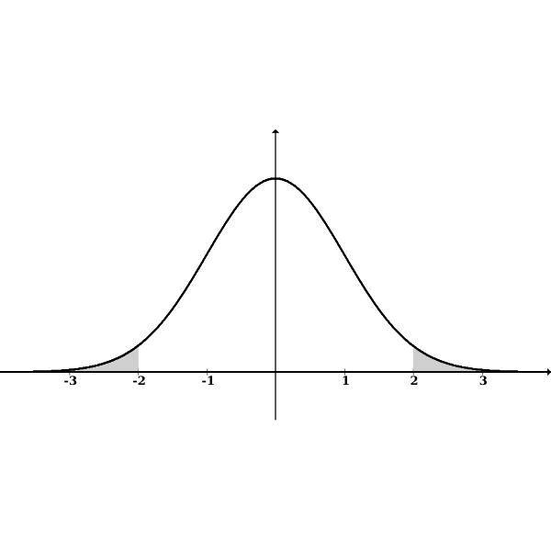
Alternative is Special
Two-Tailed
One-Tailed
JUST different
You specify HOW they are different
Higher or lower?
Notes:
There’s only one type of null hypothesis, but the alternative hypothesis is special, because it has two types! You can have a one-tailed test, or a two-tailed test. In a two-tailed test, you are just looking to see if there is A difference. You don’t care what that difference is, just that it exists. When you test, your “different cases” can fall on either side of the mean – either higher or lower than the mean, and you’d be happy. But with a one-tailed test, you have to come in trying to test to see if your data is either higher or lower than the mean. You have to have even MORE of an educated guess than with a two-tailed test. You need to be able to specify how your data will differ. This means that you’re putting all your eggs in one basket! You’re only looking at the specified top or bottom, and completely blind to the other side. What does that mean? Well, take this image on the left. You could hypothesize that the data will be lower than the mean, and test for it, and find out that it is not lower. BUT it could be higher! Your test just doesn’t test for it! So there is something unusual, and you’ll have missed it, because you were only focused on one side, lower. This risk for error means that two-tailed tests are more common, and that you really have to be sure of your knowledge of the data before entering into a one-tailed test.
As you run statistics in Excel, Python, and R throughout the course, you will often find that there are ways to specify the number of tails you want to test for. Changing that can really impact your results.

Slide 5
Scenario Practice
Notes:
So let’s try a couple practice scenarios to get rolling. These things can be hard to conceptualize without a few examples!

Slide 6
Polar bears live both in the wild and in zoos. You want to find out if the percentage of polar bears is the same in the wild and in zoos.
Null: The percentage of polar bears is the same in the wild as it is in a zoo.
Alternative: The percentage of polar bears in the wild is different than the percentage of polar bears in zoos.
One tailed: There are more polar bears in the wild than in zoos.
One tailed: There are more polar bears in the zoo than in the wild.
Notes:
Ok, so in this scenario, you are trying to determine whether you have the same number of polar bears in the wild as in zoos. Common sense might tell you no, there aren’t the same number, but let’s ignore that for the moment and just think through what the null and alternative hypotheses would be. The null is that the number of polar bears in the wild is the same as the number in the zoo. There’s no change; they’re equal. The alternative would be that there is a difference – the number of polar bears in the wild or in a zoo is NOT equal. That would be your two-tailed test. But we can get even more specific than that! You can choose to do a one-tailed test, and guess which option is going to have more polar bears – the zoo or the wild? Each option will constitute one of your one-tailed tests.

Slide 7
Is the number of pillows on my bed different than the household average?
Null: There is no difference between the number of pillows on my bed and the household average.
Alternative: There is a difference between the number of pillows on my bed and the household average.
One tailed: I have more pillows than the household average.
One tailed: I have fewer pillows than the household average.
Notes:
Ok, here’s the next scenario. I’ve got five pillows on our bed, and my husband thinks that’s excessive. Is it, though? I want to know if the number of pillows on my bed is different than the household average. So the null hypothesis would be that there’s no difference between my five pillows and the household average – that would mean that the household average is the same, 5. But the alternative would be that there is a difference! That we have a different number of pillows than the household average on the bed! That’s two-tailed – when you just generally say it is NOT the same. But you can also go one-tailed on this! You can predict that I either have more pillows than the household average, or less pillows than the household average. Either are one-tailed – they are just going in different directions.

Slide 8
Which streaming service is preferred by Americans: Netflix or Hulu?
Null: An equal number of Americans watch Netflix and Hulu.
Alternative: The number of viewers differs between streaming service.
One tailed: Americans prefer Netflix.
One tailed: Americans prefer Hulu.
Notes:
One last example. It seems like everyone is stuck inside lately, and chances are you have time to binge-watch your favorite shows! Someone wants to know if there’s a preferred streaming service – Netflix or Hulu? Well the null option is that they are equal, exactly the same. Americans show NO preference. But the alternative is that there is a difference between them – one is more well liked than the other! If you’re not specifying which, than that is the two-tailed test. But if you do want to specify which one is liked more, and which one is liked less, than you can use the one-tailed test system. Be really sure, though!
Note here that you often have to imply information from a vague question. Learning to do this early is a great data science skill! Not all employers are going to give you all the details nicely, easily laid out. So have to imply “number of views” from a question about “preference,” is important. Though there are many other ways to look at preference as well – and if you had some real data, you might want to play around with whatever you have to answer the question!

Slide 9
Accepting or Rejecting the Null
Notes:
Now that you have a solid handle on what the null and alternative hypotheses are all about, you’re going to add yet another level of complexity – actually testing them out! You will make a decision about whether to accept or reject the null hypothesis.

Slide 10
The p value
p is for probability
A statistic tests the probability that the null hypothesis is true
The smaller, the better for finding significant results
Notes:
There are two major components that come into accepting or rejecting the null hypothesis – the p value and the alpha. You’ll talk about p first. The p in p value stands for probability! It is simply the probability in any given statistical test that the null hypothesis will be true. The smaller, the better for finding significant results – because you usually want to reject the null hypothesis. So if there’s only a 1% chance that the null hypothesis is true, that’s good!

Slide 11
The α value
The benchmark that you are testing your statistic against
Three typical alphas:
α level | Accuracy Chance (Probability) | Error Chance
.01 | 99% | 1%
.05 | 95% | 5%
.10 | 90% | 10%
Notes:
The other component of hypothesis testing is the alpha. The alpha is the benchmark to which you compare the p value that comes from your statistic. So p value is generated, alpha stays static. Although you could set alpha to e absolutely anything, there are three that get used most often. .01, .05, and .10. But even in that, the one that you really, really want to pay attention to is .05. You can always assume that alpha is .05 if there is no p value stated. What does an alpha of .05 actually mean? Well, it means that you find a 5% chance of error acceptable. And on the opposite of that, because the accuracy and error together will equal 100%, it means that you’re good with a 95% chance of accuracy. That’s also the probability – so there’s a 95% chance that the null hypothesis is true, and a 5% chance that it’s false. You want to fall in that 5% range – because it means that your data really is out of the normal for that particular sample!

Slide 12
The Decision Rule
If p ≤ α : reject the null
If p > α : accept the null
Notes:
So here it comes. The. Big. Rule. If your p value is less than or equal to your alpha, you are going to reject the null hypothesis. If your p value is greater than your alpha than you will accept the null, and nothing fun or exciting has ever happened.

Slide 13
The Decision Rule, α = .05
If p ≤ .05 : reject the null
If p > .05 : accept the null
Notes:
To put it into context with that great .05 – if you p value is less than or equal to .05, reject the null. If your p value is greater than .05, reject it! Any time that an alpha is not specifically stated, you want to make use of .05.

Slide 14
Polar bears live both in the wild and in zoos. You want to find out if the percentage of polar bears is the same in the wild and in zoos.
Null: The percentage of polar bears is the same in the wild as it is in a zoo.
Alternative: The percentage of polar bears in the wild is different than the percentage of polar bears in zoos.
One tailed: There are more polar bears in the wild than in zoos.
One tailed: There are more polar bears in the zoo than in the wild.
p = .03 – Reject the null
Notes:
So let’s give this a shot. For the polar bear scenario from before, you find a p value of .03. What should you do? Well, you want to reject the null, because that is less than .05.

Slide 15
Is the number of pillows on my bed different than the household average?
Null: There is no difference between the number of pillows on my bed and the household average.
Alternative: There is a difference between the number of pillows on my bed and the household average.
One tailed: I have more pillows than the household average.
One tailed: I have fewer pillows than the household average.
p = .06 – Accept the null
Notes:
How about this one? I find a p value of .06 when testing out the number of pillows on my bed. That would be accepting the null, because it is greater than .05.

Slide 16
Which streaming service is preferred by Americans: Netflix or Hulu?
Null: An equal number of Americans watch Netflix and Hulu.
Alternative: The number of viewers differs between streaming service.
One tailed: Americans prefer Netflix.
One tailed: Americans prefer Hulu.
p = .05 – Reject the null
Notes:
Ok, last try at this! Streaming services! You find a p value of .05. Should you accept or reject the null? This one’s tricky, but you will want to reject the null, because the rule for that is less than or equal to .05!

Slide 17
Making Hypothesis Mistakes
Notes:
All that is fun. But life’s not perfect. Not everything goes as planned. Not everything is as it seems! So sometimes, you, through no fault of your own, but through the statistic instead, can accidentally accept or reject the null hypothesis when you really shouldn’t have, because what the statistic comes up with doesn’t actually match reality. That is called error!

Slide 18
Error
Type I
Type II
Reject the null when you shouldn’t
Say there’s a difference when there’s not
False Positive
Accept the null when you shouldn’t
Say there’s no difference when there is
False Negative
Notes:
There are two types of errors – type I and type II. For Type I, you reject the null when you shouldn’t. Put a different way, you say that there is a difference between things but there really isn’t. You can also think of this as a false positive if that helps.
Type II error, you end up accepting the null when you shouldn’t. So you think you haven’t found anything statistically significant, when you really have. This is also known as a false negative. Sometimes those terms can help keep your thinking on straight.

Slide 19
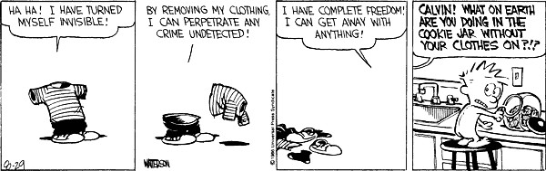
Type I Error
Null: Visible
Alternative: Invisible
Calvin rejected the null when he shouldn’t have!
Notes:
Comics! And statistics! What could be better?! I am personally a huge fan of Calvin and Hobbes. In this case, Calvin’s rejected the null, that he’s visible, when he totally shouldn’t have. That’s a great case of Type I error right there!

Slide 20
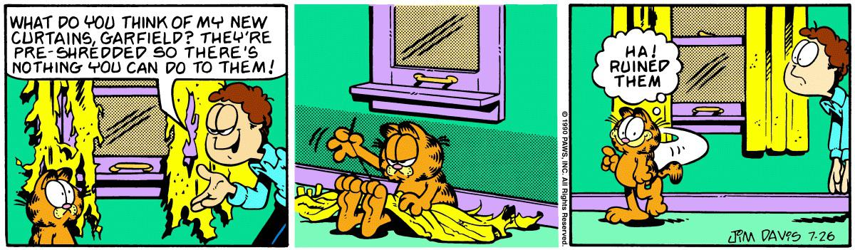
Type II Error
Null: Garfield can’t ruin the drapes
Alternative: Garfield can ruin the drapes
John accepted the null when he shouldn’t have!
Notes:
And here’s a great example of Type II error, from the Garfield annex. Garfield is my husband’s favorite comic, and believe or not, I just asked him to give me an example of Type II error off the top of his head and he could point right to this one! John is accepting the null here, that Garfield can’t ruin the drapes, when he shouldn’t. Garfield can ruin the pre-shredded drapes…by sewing them back together!

Slide 21
Polar bears live both in the wild and in zoos. You want to find out if the percentage of polar bears is the same in the wild and in zoos.
Null: The percentage of polar bears is the same in the wild as it is in a zoo.
Alternative: The percentage of polar bears in the wild is different than the percentage of polar bears in zoos.
One tailed: There are more polar bears in the wild than in zoos.
One tailed: There are more polar bears in the zoo than in the wild.
p = .03 – Reject the null
Type I error: Accept the null
Notes:
So going back to our three fun examples from earlier…if you committed type I error here, you would accidentally accept the null. That means that you would say that the same number of polar bears live in zoos as in the wild, when they really are not the same amount.

Slide 22
Is the number of pillows on my bed different than the household average?
Null: There is no difference between the number of pillows on my bed and the household average.
Alternative: There is a difference between the number of pillows on my bed and the household average.
One tailed: I have more pillows than the household average.
One tailed: I have fewer pillows than the household average.
p = .06 – Accept the null
Type II error – Reject the null
Notes:
If you had a Type II error in this scenario, you would reject the null, which means that you would say that the number of pillows on my bed is significantly different from the household average, when it’s really not.

Slide 23
Which streaming service is preferred by Americans: Netflix or Hulu?
Null: An equal number of Americans watch Netflix and Hulu.
Alternative: The number of viewers differs between streaming service.
One tailed: Americans prefer Netflix.
One tailed: Americans prefer Hulu.
p = .05 – Reject the null
Type I error: Accept the null
Notes:
And lastly, if you were to commit a type I error here, you would find that you have accidentally accepted the null when you should not have. So, you would say that each streaming service gets the same number of viewers, and Americans don’t have a preference.

Slide 24
Questions?

